Slide 1

CHEM-1109: Chemistry
Dr. A. K. M. Nur Alam Siddiki
Associate Professor
Department of Chemistry, University of Dhaka
Email: nuralam@hotmail.com
Cell: 01716580850
Website: nasiddiki.com
Notes:
Thank you Dr. Balkus for your kind Introduction. Good afternoon everyone. Welcome to my final oral examination presentation. The title of my thesis is “WRINKLED MESOPOROUS SILICA encapsulated nanoparticles."

Slide 2



PhD in Chemistry
UT Dallas
Notes:
So, the porous materials are a type of materials that has empty space in it’s structure. The porous materials are classified based on their pore size as: Microporous materials, mesoporous materials and microporous materials.
Microporous Materials have pores with diameters less than 2 nm. Examples of these microporous materials include zeolites, and metal-organic frameworks (MOFs).
Mesoporous Materials have pores with diameters ranging from 2 nm to 50 nm. Examples of mesoporous materials are mesoporous silica, and mesoporous carbon.
Macroporous Materials have larger pores with diameters exceeding 50 nm. For example macroporous glass, porous foams, macroporous membranes, and certain polymers can exhibit macroporosity.

Slide 3

MS - 1st Class 1st
BS - 1st Class 3rd
Department Of Chemistry, DU
Notes:
So, the porous materials are a type of materials that has empty space in it’s structure. The porous materials are classified based on their pore size as: Microporous materials, mesoporous materials and microporous materials.
Microporous Materials have pores with diameters less than 2 nm. Examples of these microporous materials include zeolites, and metal-organic frameworks (MOFs).
Mesoporous Materials have pores with diameters ranging from 2 nm to 50 nm. Examples of mesoporous materials are mesoporous silica, and mesoporous carbon.
Macroporous Materials have larger pores with diameters exceeding 50 nm. For example macroporous glass, porous foams, macroporous membranes, and certain polymers can exhibit macroporosity.

Slide 4



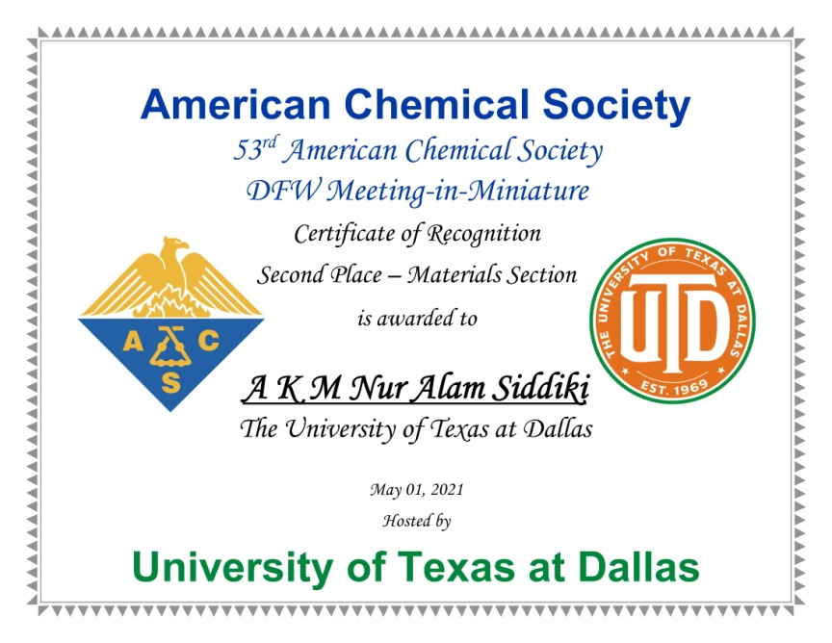
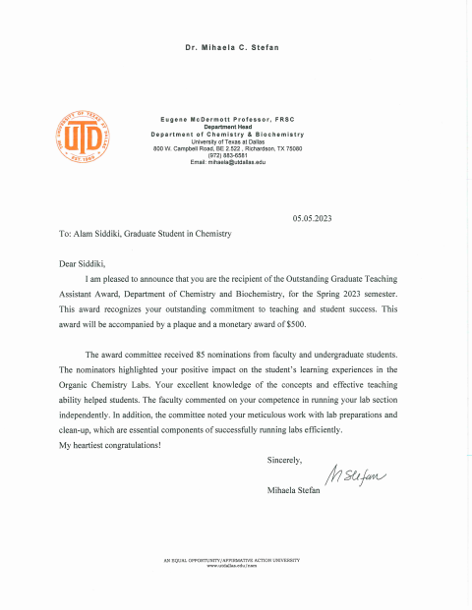
Awards and Recognition

Slide 5
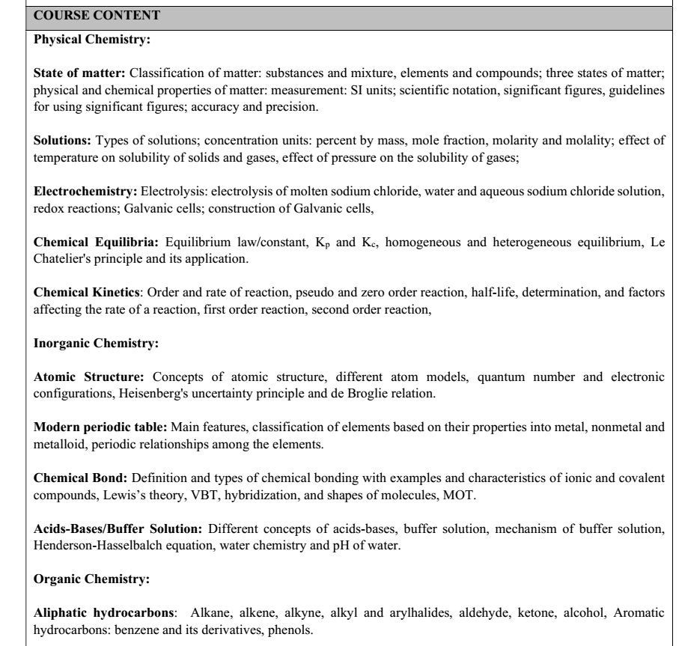

Slide 6

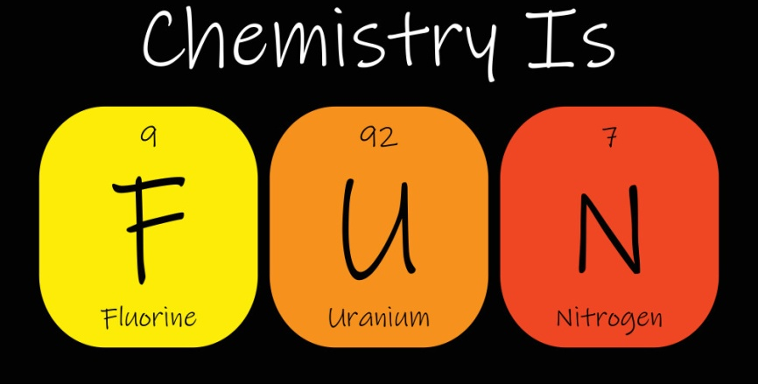

Slide 7
Contents
Classification of matter: substances and mixture, elements and compounds; three states of matter, physical and chemical properties of matter. Measurement: SI units; scientific notation, significant figures, guidelines for using significant figures; accuracy and precision

Slide 8
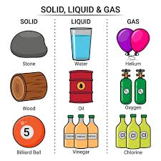
Matter is anything that has mass and occupies space. It exists in different forms and can be classified based on its composition.
Matter can be broadly classified into two main categories:
Pure Substances
Mixtures

Slide 9
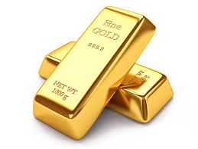
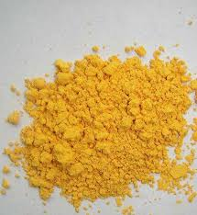
Pure Substances
A pure substance has a uniform and definite composition. It cannot be separated into other kinds of matter by physical methods. Pure substances are further classified into:
a. Elements
  An element is a substance that consists of only one type of atom.
  It cannot be broken down into simpler substances by chemical means.
  Elements are represented using symbols from the periodic table (e.g., H for
  Hydrogen, O for Oxygen, Fe for Iron).
  Examples: Oxygen (O₂), Gold (Au), Copper (Cu), Iron (Fe).
b. Compounds
  A compound consists of two or more elements chemically combined in a fixed ratio.
  It can be broken down into simpler substances by chemical methods.
  The properties of a compound differ from those of its constituent elements.
  Examples: Water (H₂O), Carbon dioxide (CO₂), gold chloride (AuCl₃), Methane (CH₄).
Gold (Au)
AuCl₃

Slide 10

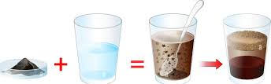
Mixtures
A mixture is a combination of two or more substances that are physically blended but not chemically combined. The components of a mixture can be separated by physical methods such as filtration, distillation, or chromatography. Mixtures are classified into:
a. Homogeneous Mixtures (Solutions)
  A homogeneous mixture has a uniform composition throughout.
  The components are evenly distributed and cannot be distinguished.
  Examples: Saltwater, Air, Alloys (Brass - Cu & Zn), Vinegar (Acetic acid in water).
b. Heterogeneous Mixtures
  A heterogeneous mixture does not have a uniform composition.
  The components are distinct.
  Examples: Sand and water, Oil and water.

Slide 11
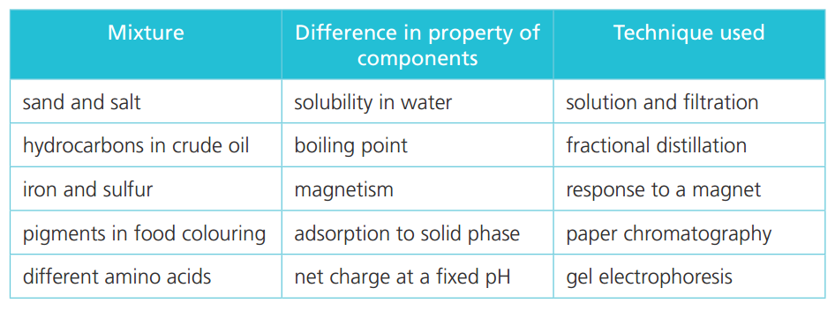
Because the components retain their individual properties in a mixture, we can often separate them relatively easily. The technique we choose to achieve this will take advantage of a suitable difference in the physical properties of the components, as shown in the table below. Many of these are important processes in research and industry.

Slide 12
Differences Between Elements, Compounds, and Mixtures
Property | Element | Compound | Mixture
Composition | Single type of atom | Two or more elements chemically combined | Two or more substances physically combined
Separation Method | Cannot be broken down | Separated by chemical means | Separated by physical means
Properties | Retains original properties | Has different properties from its components | Retains properties of individual components
Example | Gold (Au), Iron (Fe) | Water (H₂O), Carbon dioxide (CO₂) | Air (homogeneous), Sand and water (heterogeneous)

Slide 13
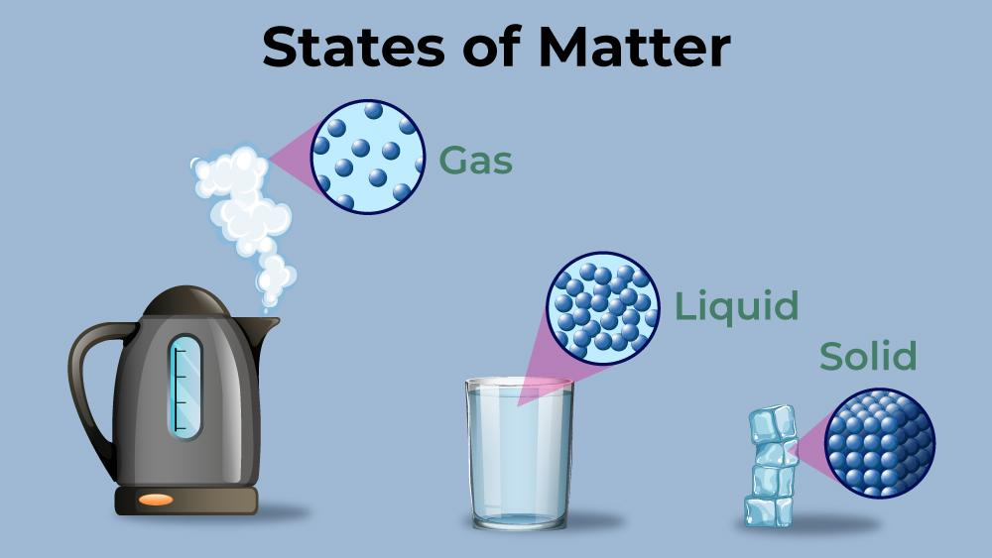
From our everyday experience, we know that all matter (elements, compounds, and mixtures) can exist in different forms depending on the temperature and pressure. Liquid water changes into a solid form such as ice as the temperature drops and it becomes a gas (steam) at high temperatures. These different forms of matter are known as the states of matter.

Slide 14
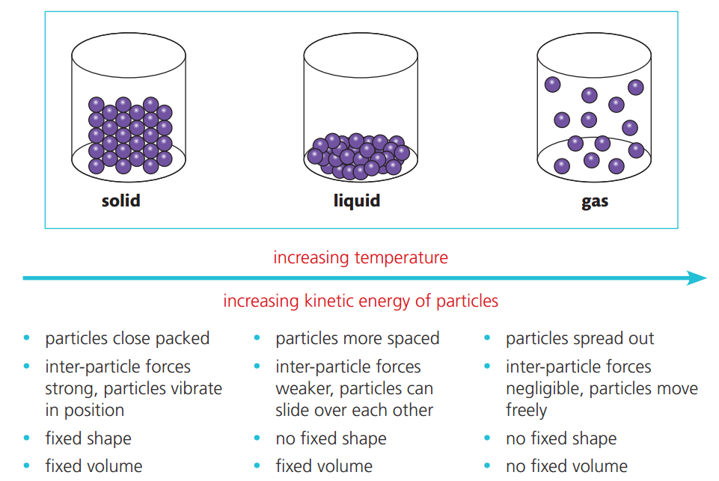

Slide 15
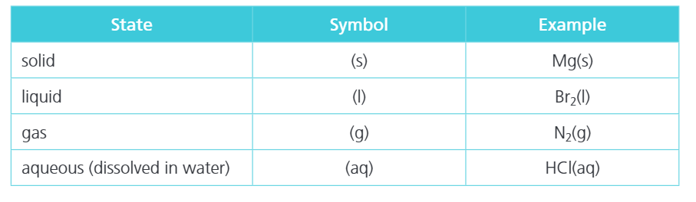

State symbols are used to show the states of the reactants and products taking part in a reaction. These are abbreviations, which are given in brackets after each term in an equation, as shown below.

Slide 16
Physical and chemical properties are essential in various scientific and industrial applications, including material selection, chemical reactions, and product development.
Physical properties
Physical properties are characteristics of a substance that can be observed or measured without altering its chemical identity. These properties can be classified into intensive and extensive properties.
1. Intensive Properties (Independent of Amount)
These properties do not depend on the quantity of the substance present.
  Color – The appearance of a substance.
  Odor – The scent that a substance emits.
  Density – Mass per unit volume (e.g., g/cm³).
  Boiling Point – The temperature at which a liquid changes to a gas.
  Melting Point – The temperature at which a solid turns into a liquid.
  Solubility – The ability of a substance to dissolve in a solvent.
  Refractive Index – The measure of how light bends when passing through a material.
  Electrical Conductivity – The ability of a substance to conduct electricity.
  Thermal Conductivity – The ability of a substance to transfer heat.

Slide 17
2. Extensive Properties (Dependent on Amount)
These properties depend on the quantity of the substance.
  Mass – The amount of matter in a sample.
  Volume – The space occupied by a substance.
  Length – The measurement of an object’s size.
  Shape – The external form or structure of a substance.

Slide 18
Chemical Properties of Matter
Chemical properties describe how a substance interacts with other substances and undergoes chemical changes. These properties can only be observed during a chemical reaction.
Common Chemical Properties
  Reactivity – The tendency of a substance to undergo a chemical reaction with other substances Flammability – The ability of a substance to catch fire and burn in the presence of oxygen.
  Oxidation State – The capacity of a substance to gain or lose electrons during a reaction.
  Toxicity – The harmful effects a substance can have on living organisms.
  Acidity/Basicity – Determines whether a substance is an acid (pH < 7) or a base (pH > 7).
  Corrosiveness – The ability of a substance to degrade or corrode metals and other materials.
  Heat of Combustion – The amount of energy released when a substance undergoes complete combustion.
  Decomposition – The breakdown of a compound into simpler substances.

Slide 19
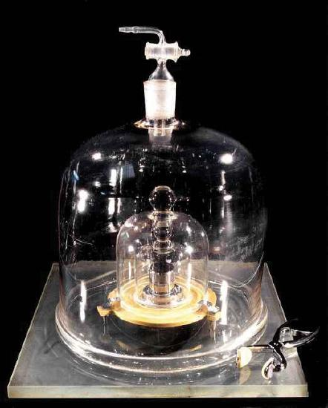
Science use the International System of Units (also known as SI after Système Internationale d’Unités), which was established so that scientists around the world could communicate efficiently with each other.
The Seven Base SI Units
Property | Unit | Abbreviation
length | meter | m
mass | kilogram | kg
time | second | s
amount | mole | mol
temperature | kelvin | K
electrical current | ampere | amp
luminous intensity | candela | cd
The size of each base unit is defined by international convention. For example, the kilogram is defined as the quantity of mass of a special metal cylinder kept in a vault in France
The Kilogram

Slide 20
SI also provides a series of prefixes that can be attached to the units, creating units that are larger or smaller by powers of 10.
Prefixes Used with SI Units
Prefix | Abbreviation | Multiplicative Factor | Multiplicative Factor in Scientific Notation
giga- | G | 1,000,000,000 × | 10⁹ ×
mega- | M | 1,000,000 × | 10⁶ ×
kilo- | k | 1,000 × | 10³ ×
deca- | D | 10 × | 10¹ ×
deci- | d | 1/10 × | 10⁻¹ ×
centi- | c | 1/100 × | 10⁻² ×
milli- | m | 1/1,000 × | 10⁻³ ×
micro- | µ* | 1/1,000,000 × | 10⁻⁶ ×
nano- | n | 1/1,000,000,000 × | 10⁻⁹ ×
*The letter µ is the Greek lowercase letter for m and is called “mu,” which is pronounced “myoo.”

Slide 21
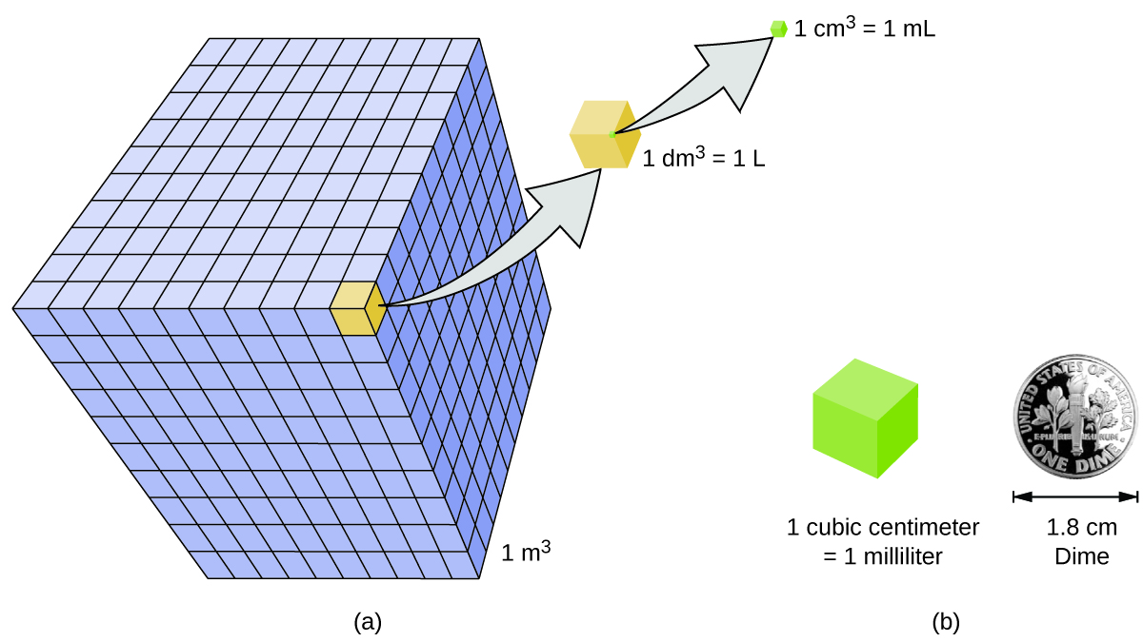

Slide 22
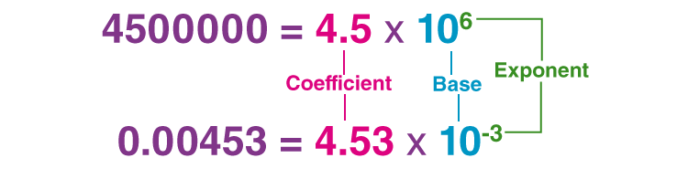
Scientific Notation
Scientific notation is a way to express numbers as the product of two numbers: a coefficient and the number 10 raised to a power (base). It is a very useful tool for working with numbers that are either very large or very small. As an example, the distance from Earth to the Sun is about 150,000,000,000 meters ((150 billion m) —a very large distance indeed.
In scientific notation, the distance is written as 1.5×10¹¹ m. The coefficient is the 1.5 and must be a number greater than or equal to 1, and less than 10. The power of 10, or exponent, is 11 because you would have to multiply 1.5 by 10¹¹ to get the correct number. Scientific notation is sometimes referred as exponential notation.
Notes:
https://byjus.com/maths/scientific-notation/

Slide 23
Scientific Notation Rules
To determine the power or exponent of 10, we must follow the rule listed below:
  The base should be always 10
  The exponent must be a non-zero integer, that means it can be either positive or negative
  The absolute value of the coefficient is greater than or equal to 1 but it should be less than 10
  Coefficients can be positive or negative numbers including whole and decimal numbers
  1. If the given number is multiples of 10 then the decimal point has to move to the left, and the power of 10 will be positive.
  Example: 6000 = 6 × 10³ is in scientific notation.
2. If the given number is smaller than 1, then the decimal point has to move to the right, so the power
of 10 will be negative.
Example: 0.006 = 6 × 0.001 = 6 × 10⁻³ is in scientific notation.

Slide 24
Scientific measurements are reported so that every digit is certain except the last, which is estimated. Significant figures (sig figs) are the digits in a number that carry meaning about its precision. They are crucial in scientific measurements and calculations to ensure accuracy and proper representation of uncertainty.
Rules for Identifying Significant Figures
Non-Zero Digits Are Always Significant:
  Example: 123.45 has 5 significant figures.
Leading Zeros Are Not Significant:
  Example: 0.0045 has 2 significant figures (4 and 5).
Captive (Embedded) Zeros Are Significant:
  Example: 1004 has 4 significant figures.
Trailing Zeros in a Decimal Number Are Significant:
  Example: 45.00 has 4 significant figures.
  Example: 0.780 has 3 significant figures.
Trailing Zeros in a Whole Number Without a Decimal Are Not Significant:
  Example: 100 has 1 significant figure.

Slide 25
Rounding Rules
If the digit to be dropped is less than 5, leave the preceding digit unchanged.
Example: 4.347 rounded to 3 significant figures → 4.34.
2. If the digit to be dropped is 5 or greater, round up the preceding digit.
  Example: 0.03257 rounded to 3 significant figures → 0.0326.

Slide 26
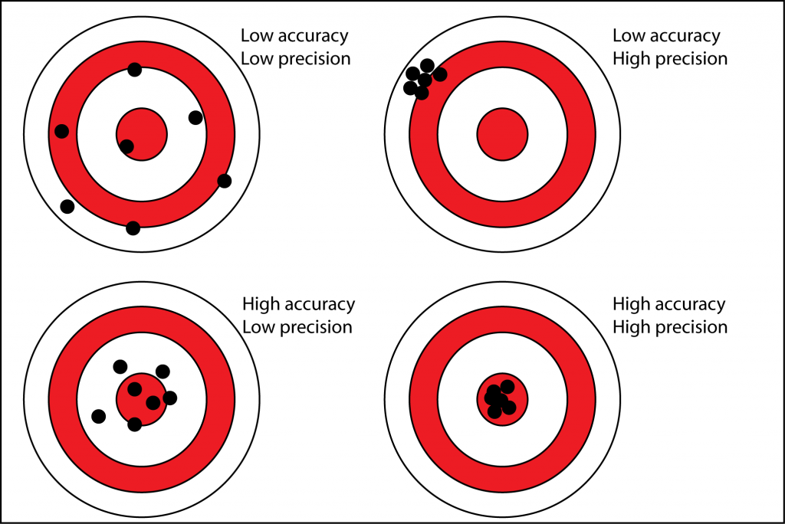

Slide 27
Accuracy
The ability of an instrument to measure the accurate value is known as accuracy. In other words, it is the the closeness of the measured value to a standard or true value. Accuracy is obtained by taking small readings. The small reading reduces the error of the calculation. The accuracy of the system is classified into three types as follows:
    Point Accuracy
The accuracy of the instrument only at a particular point on its scale is known as point accuracy. It is important to note that this accuracy does not give any information about the general accuracy of the instrument.
    Accuracy as Percentage of Scale Range
The uniform scale range determines the accuracy of a measurement. This can be better understood with the help of the following example:
Consider a thermometer having the scale range up to 500ºC. The thermometer has an accuracy of ±0.5 percent of scale range i.e. 0.005 x 500 = ± 2.5 ºC. Therefore, the reading will have a maximum error of ± 2.5 ºC.
    Accuracy as Percentage of True Value
Such type of accuracy of the instruments is determined by identifying the measured value regarding their true value. The accuracy of the instruments is neglected up to ±0.5 percent from the true value.

Slide 28
Precision
The closeness of two or more measurements to each other is known as the precision of a substance. If you weigh a given substance five times and get 3.2 kg each time, then your measurement is very precise but not necessarily accurate. Precision is independent of accuracy. The below examples will tell you about how you can be precise but not accurate and vice versa. Precision is sometimes separated into:
    Repeatability
The variation arising when the conditions are kept identical and repeated measurements are taken during a short time period.
    Reproducibility
The variation arises using the same measurement process among different instruments and operators, and over longer time periods.

Slide 29
Difference between Accuracy and Precision
Accuracy | Precision
Accuracy refers to the level of agreement between the actual measurement and the absolute measurement. | Precision implies the level of variation that lies in the values of several measurements of the same factor.
Represents how closely the results agree with the standard value. | Represents how closely results agree with one another.
Single-factor or measurement are needed. | Multiple measurements or factors are needed to comment about precision.
It is possible for a measurement to be accurate. For a measurement to be consistently accurate, it should also be precise. | Results can be precise without being accurate. Alternatively, the results can be precise and accurate.

Slide 30
What is the primary difference between an element and a compound?
What is the primary difference between a gas and a liquid?
How many significant figures are in the measurement 0.05020 g?
Express 0.0000456 in scientific notation.
What is meant by accuracy and precision?
What is the difference between accuracy and precision in measurements?
Which of the following is a pure substance and why?
a) Air
b) Saltwater
c) Carbon dioxide
d) Steel
Which statement is TRUE about homogeneous and heterogeneous mixtures?
a) Homogeneous mixtures have a uniform composition throughout.
b) Heterogeneous mixtures are always in the liquid state.
c) Homogeneous mixtures can be separated by filtration.
d) Heterogeneous mixtures have only one phase.
Which of the following describes a chemical property of a substance?
a) Melting point
b) Density
c) Reactivity with oxygen
d) Solubility in water

Slide 31

Download Link

